Slide 1
Introduction to HPC
HIGH PERFORMANCE COMPUTING
YALE PATHWAYS SUMMER WORKSHOP

Slide 2


Slide 3
LEARNING GOALS
What is a computer, and how does it “compute”?
What makes supercomputers super?
Some examples of supercomputers in action

Slide 4
LEARNING GOALS
What is a computer, and how does it “compute”?
What makes supercomputers super?
Some example of supercomputers in action

Slide 5

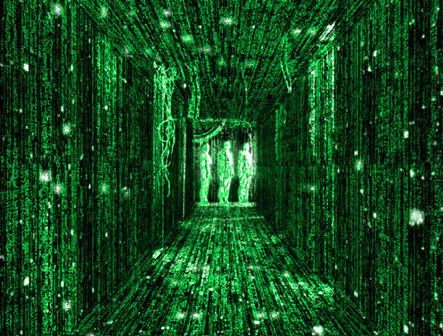
The Building Blocks of a Computer
Computers store and process information in the form of ones (1) and zeros (0)
Binary code – every letter/number/instruction is encoded as a specific digital string of 1’s and 0’s
Physically, every one or zero is represented by a transistor
Each transistor can be thought of as a switch
“On”=1 and “off”=0
A small electrical voltage is used to switch the transistor from “off” to “on”

Slide 6
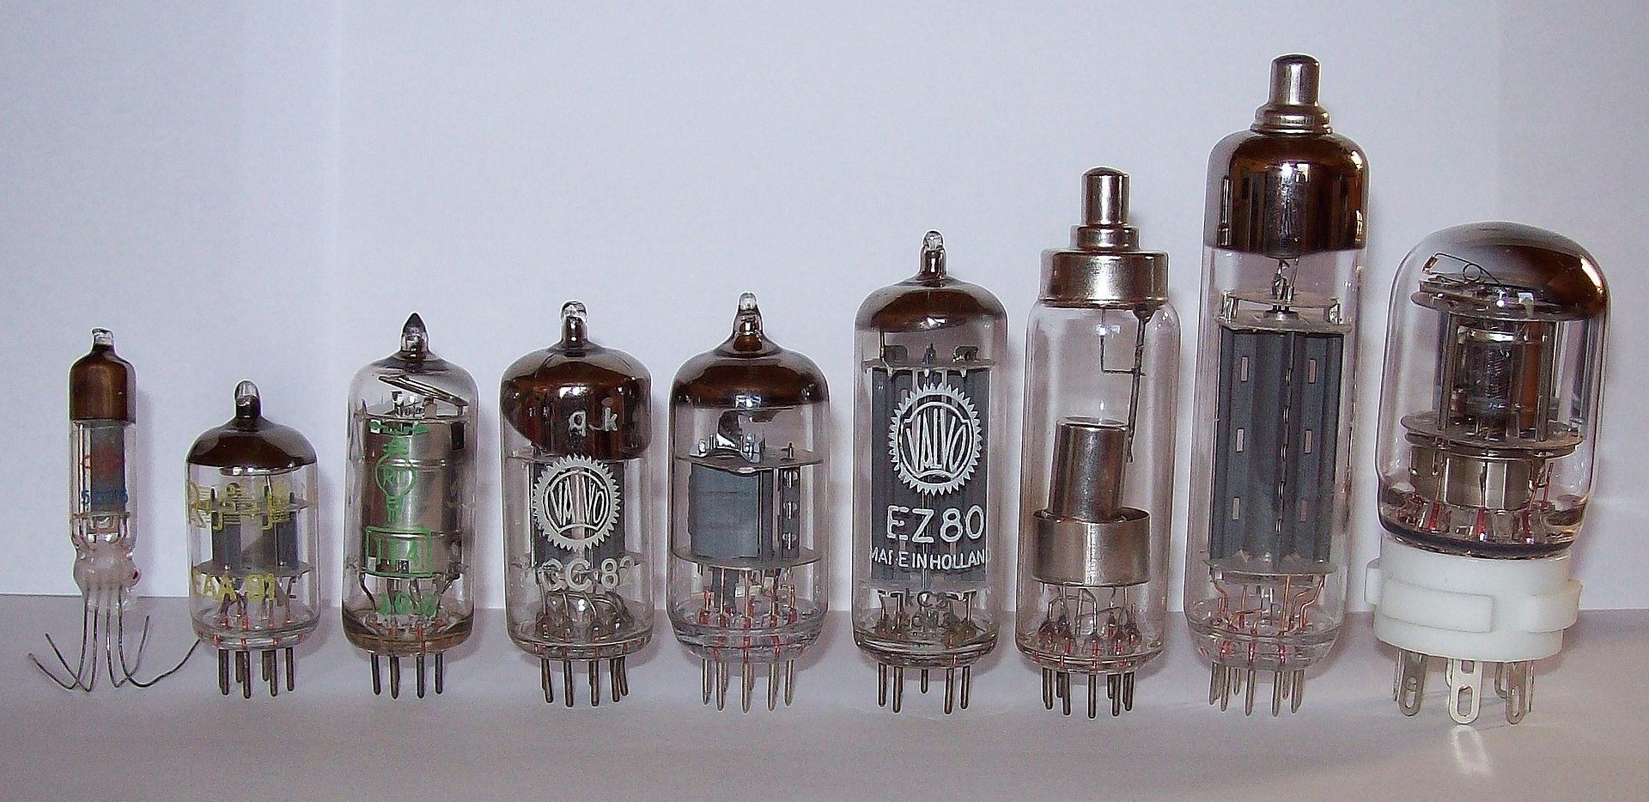
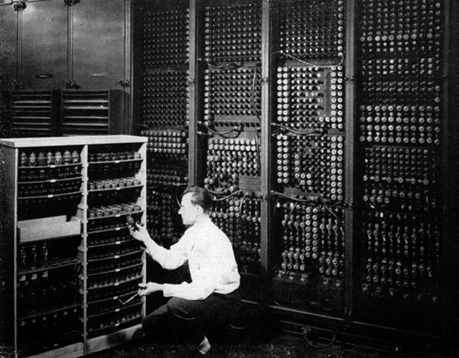
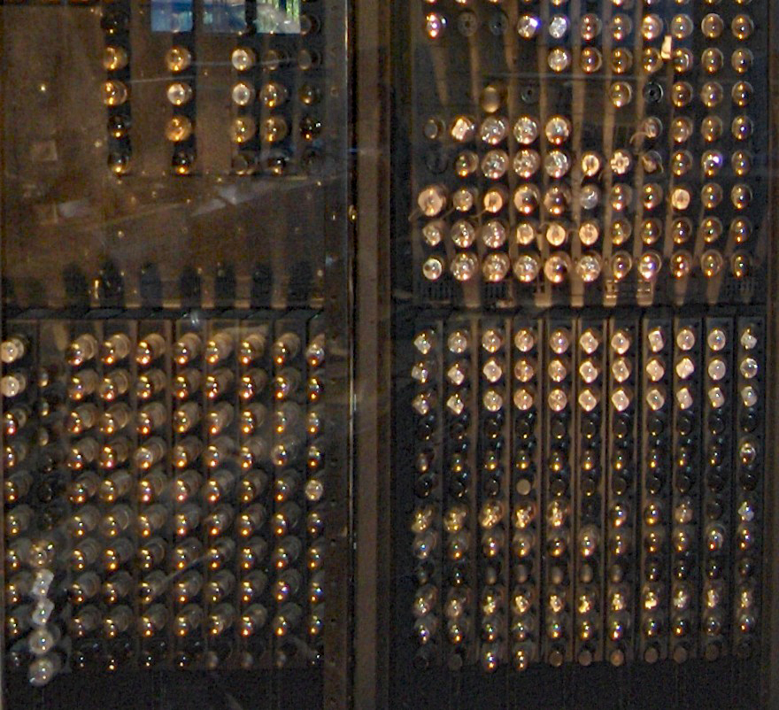
The Building Blocks of a Computer
Earliest 1’s and 0’s were vacuum tubes
A lot like a light bulb!
1945 – ENIAC (Electronic Numerical Integrator and Computer), the first programmable, electronic, digital computer, is invented at the University of Pennsylvania
17,468 vacuum tubes!
ENIAC lost one vacuum tube roughly every day or two. With almost 18,000 tubes, locating and replacing the failed one was challenging. Over time, however, the maintenance team developed the skill to fix a problem in just 15 minutes.

Slide 7
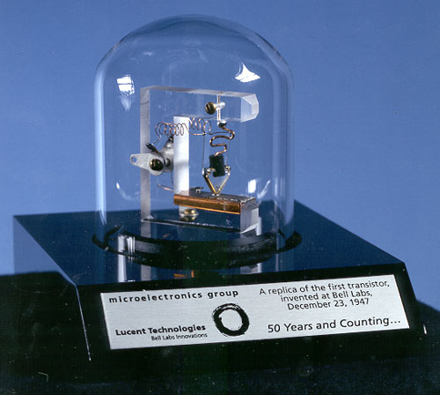
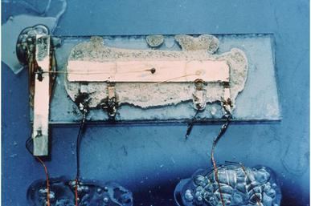
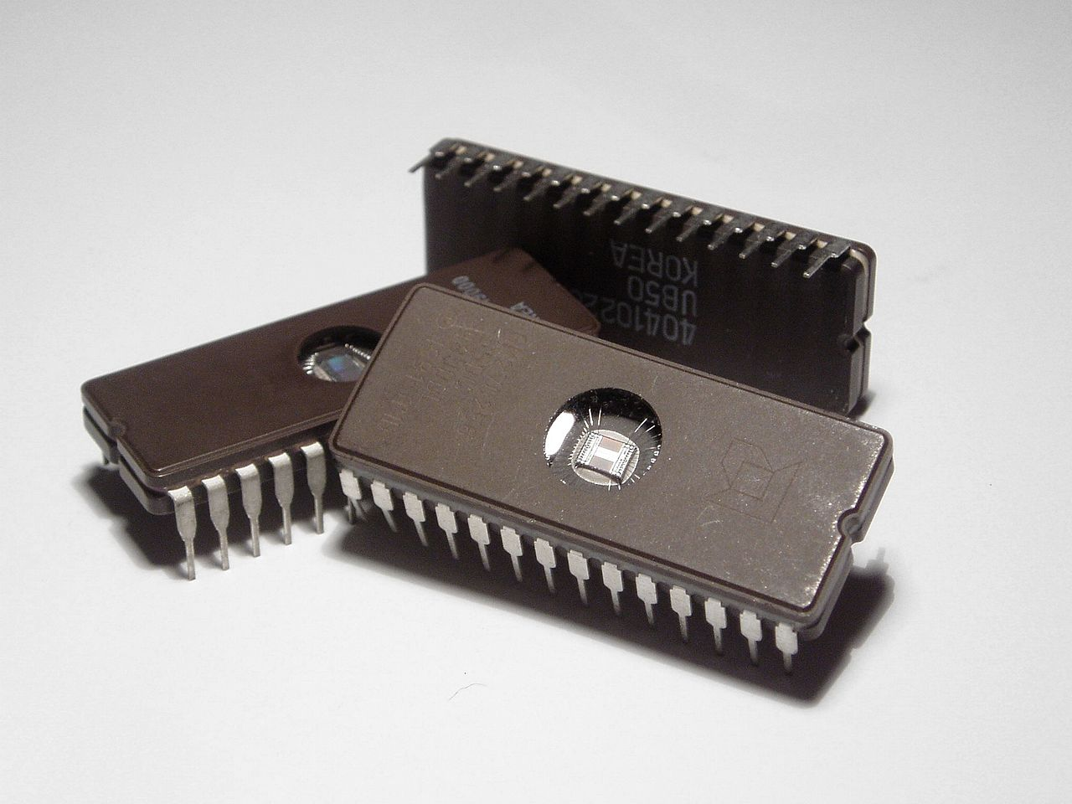
The Building Blocks of a Computer
1947 – John Bardeen and Walter Brattain invent the first transistor at Bell labs
Three terminal switch
Applying a voltage through one terminal allows current to flow through the other two terminals
1956 Bardeen, Brattain and Shockley share the Nobel prize in physics
Challenge – many transistors have to be connected together to make a computer
1957 – Jack Kilby invents the first integrated circuit at Texas Instruments
Many transistors integrated together on a single chip
2000 Kilby wins Nobel Prize

Slide 8
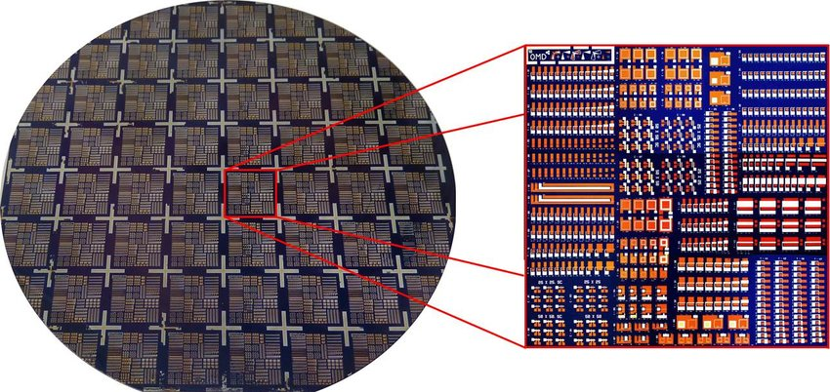
History of the Microchip
Over the years, transistors get smaller and smaller, so you can fit more of them on a single chip
How many transistors do you need?
1 bit (0 or 1) is stored in 6 transistors
1 byte = 8 bits
1 GB = 1 billion bytes
Quiz: I have an external hard drive with 128 GB of memory. Approximately how many transistors does it contain?
A) 128 billion
B) 1 trillion
C) 6.1 trillion
D) 768 billion
Photograph of a lithographically patterned 100 mm Si wafer (left) and a zoom shot of a single chip (10 mm × 10 mm) with various transistor, capacitor and inverter structures (right).

Slide 9
History of the Microchip
Over the years, transistors get smaller and smaller, so you can fit more of them on a single chip
How many transistors do you need?
1 bit (0 or 1) is stored in 6 transistors
1 byte = 8 bits
1 GB = 1 billion bytes
Quiz: I have a hard drive with 128 GB of memory. Approximately how many transistors does it contain?
A) 128 billion
B) 1 trillion
C) 6.1 trillion = 6x8x128,000,000,000
D) 768 billion
Photograph of a lithographically patterned 100 mm Si wafer (left) and a zoom shot of a single chip (10 mm × 10 mm) with various transistor, capacitor and inverter structures (right).

Slide 10
LEARNING GOALS (Break)
What is a computer, and how does it “compute”?
What makes supercomputers super?
Some example of supercomputers in action

Slide 11
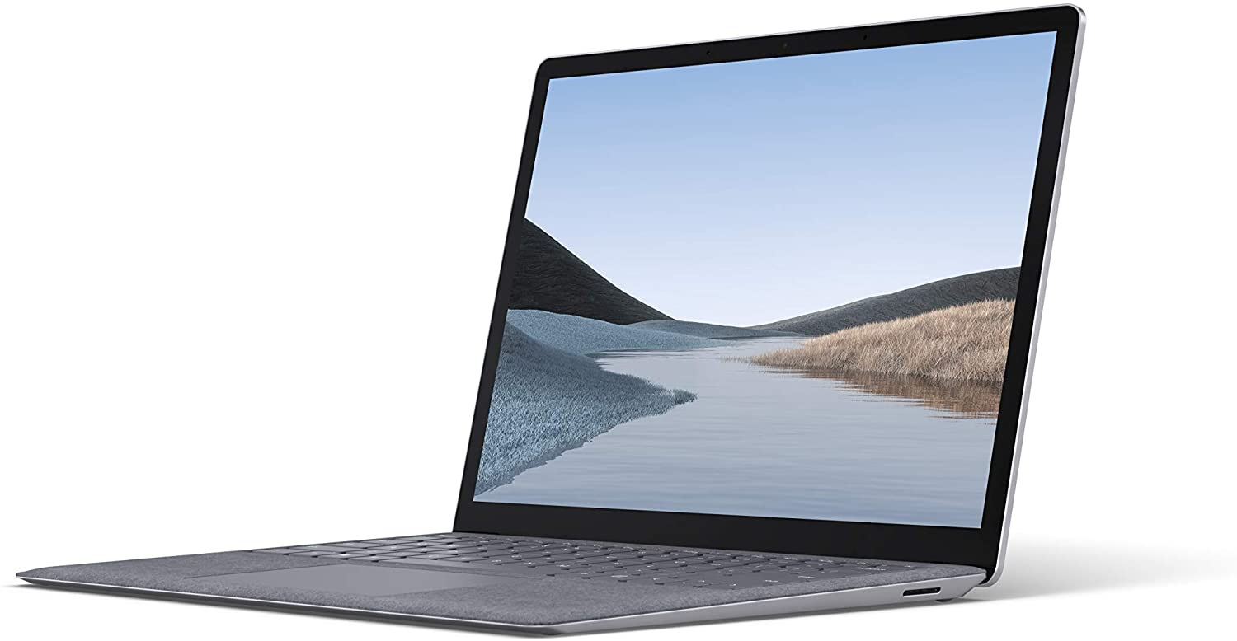
What makes supercomputers super?
Computer Cluster
Personal Computer
Most of our everyday computing needs can be met by a personal computer, like a laptop or tablet.
When more computing power is needed, we can connect multiple computers (or chips) together. This is called a computer cluster.

Slide 12
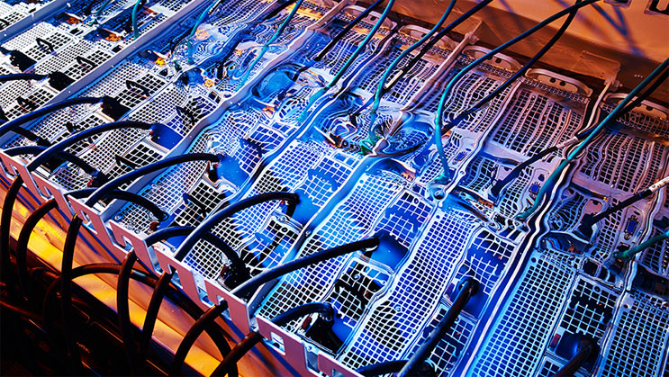
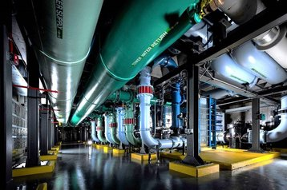
What makes supercomputers super?
No precise definition
In a supercomputer, a large number of CPUs or cores work together.
Typically modern supercomputers have 100,000-10,000,000 cores
Unlike the cloud, computers making up a supercomputer are housed in one location, making them useful for computing tasks where the computers have to share information rapidly
Special types of programming and chip architecture are needed to facilitate communication between all the cores.
Special cooling systems are needed to keep supercomputers from over-heating

Slide 13
What makes supercomputers super?
Supercomputer performance is measured by Floating Point Operations Per Second (FLOPS or FLOP/s)
A floating point number is a string of bits that represent a real number with decimal places (e.g. 1.000, 3.14, 52.7777)
In computers, numbers are stored in 32 bits.
A 32 bit floating point number can store up to 7 digits
For example: the number 1/3 is stored as 0.3333333 and 1/2 is stores as 0.5000000
Question: how is the number 2/3 stored? 0.6666667
32 bit numbers are called single precision
If greater accuracy is required, which is the case in most scientific computing, double precision numbers are stored in 64 bits

Slide 14
What makes supercomputers super?
Supercomputer performance is measured by Floating Point Operations Per Second (FLOPS or FLOP/s)
A floating point operation (or FLOP) is a single arithmetic operation, such as addition, subtraction, miultiplication, or division) involving floating point numbers
Question: Which of the following mathematical operations represents a FLOP?
A) 2 x 3
B) 1.0 x 2.0 x 3.0
C) 2.0 x 3
D) 2.0 x 3.0

Slide 15
What makes supercomputers super?
Supercomputer performance is measured by Floating Point Operations Per Second (FLOPS or FLOP/s)
A floating point operation (or FLOP) is a single arithmetic operation, such as addition, subtraction, miultiplication, or division) involving floating point numbers
Question: Which of the following mathematical operations represents a FLOP?
A) 2 x 3
B) 1.0 x 2.0 x 3.0
C) 2.0 x 3
D) 2.0 x 3.0
Computing performance is measured by how many floating point operations a computer can do in 1 second

Slide 16
What makes supercomputers super?
Number of FLOPS achieved by different types of computers:
(1969) Apollo 11 guidance computer
12,245 FLOPS
(1997) IBM’s Deep Blue “chess computer”
11.38 billions FLOPS = 11.38 GFLOPS
(1997) Intel ASCI Red/9152 – world’s fastest supercomputer in 1997
1.338 trillion FLOPS = 1.338 TFLOPS
(2020) iPhone 12
16 cores
11 TFLOPS
Today, a single chip typically achieves ~1 TFLOP/s

Slide 17
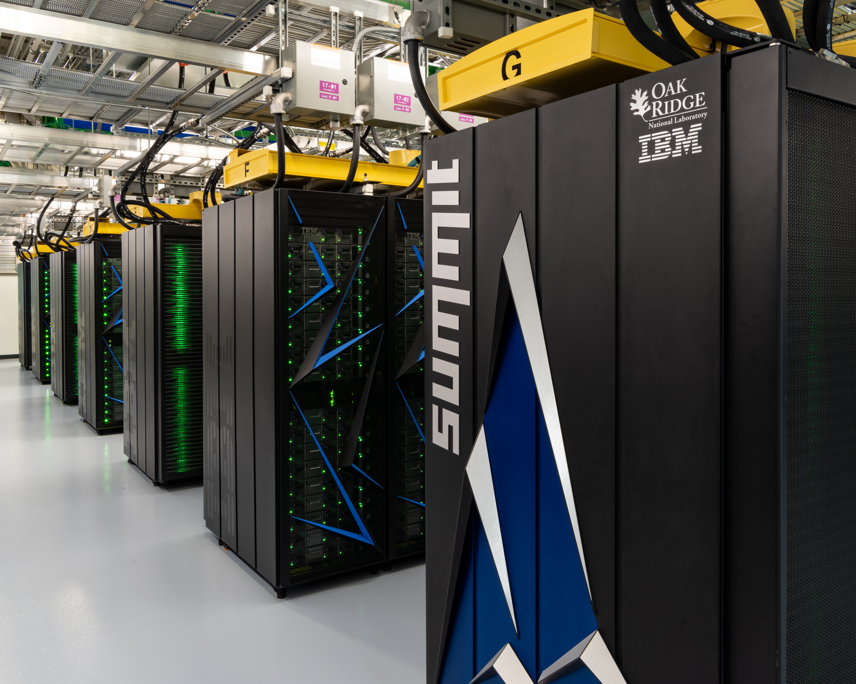
What makes supercomputers super?
Today’s fastest supercomputers:
Rank | Computer | Country | PETAFLOPS*
1 | Fugaku | Japan | 442
2 | Summit | USA | 149
3 | Sierra | USA | 95
4 | Sunway TaihuLight | China | 93
* Note: 1 PETAFLOP = 10¹⁵ FLOPS= 1 quadrillions FLOPS

Slide 18
LEARNING GOALS (Break)
What is a computer, and how does it “compute”?
What makes supercomputers super?
Some example of supercomputers in action

Slide 19
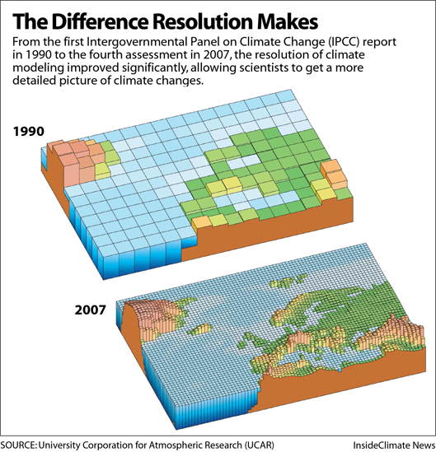
What can supercomputers be used for?
Modeling Climate Change
Climate scientists have developed sophisticated models that can be used to predict broad changes in Earth’s climate
But it’s hard to make accurate predictions about how climate change will affect specific areas, in part because it is hard to model clouds precisely.
Advances in supercomputing have enabled the development of more detailed models with greater spatial resolution

Slide 20
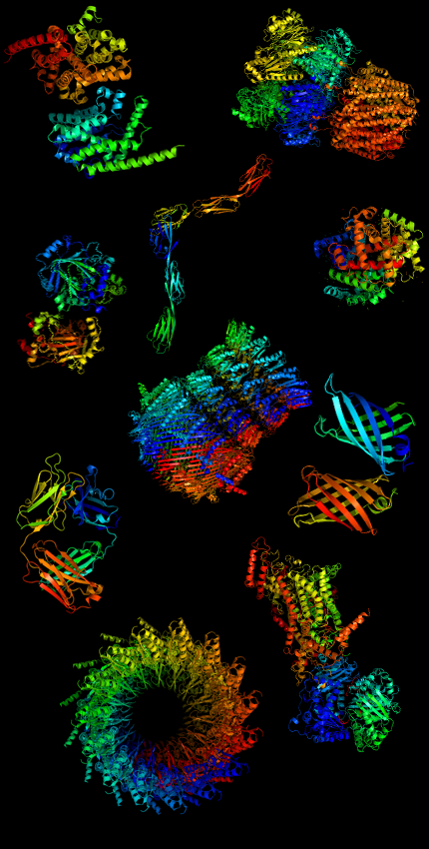
What can supercomputers be used for?
Understanding Opioid Addiction
Around 130 Americans lose their lives every day due to opioid-related overdoses
About 10% of people who prescribed opioid painkillers become addicted. This suggests there is a strong genetic component to addiction.
The Summit supercomputer (led by Daniel Jacobson at Oak Ridge National Lab) has been used to analyze genetic data to understand both opioid addiction and pain response
Identifying the relevant genes could be used to prevent addiction

Slide 21
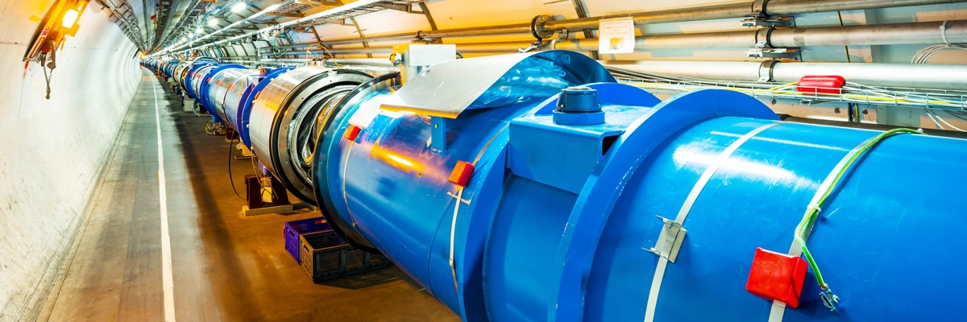
What can supercomputers be used for?
Discovering fundamental building blocks of the universe
Particle physicists discover new particles by colliding them together at high speeds in particle accelerators
These collisions generate an enormous amount of data. CERN, the largest accelerator, generates 50 Petabytes of data per day
Printed out, this would be about 50 trillion pages. It would take a human about 100 million years non-stop to read all this data.
It’s a good thing supercomputers can help with the analysis!

Slide 22
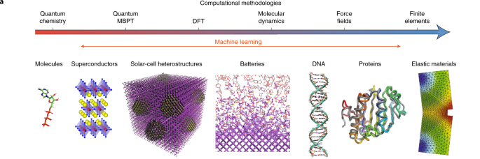
What can supercomputers be used for?
Discovering new materials – What we’re going to do in this workshop!

